Slide 1

Logging and monitoring
Tools: Grafana and prometheus

Slide 2
What is Grafana
Grafana is an open source solution for running data analytics, pulling up metrics that make sense of the massive amount of data & to monitor our apps with the help of cool customizable dashboards.
Grafana connects with every possible data source, commonly referred to as databases such as Graphite, Prometheus, Influx DB, ElasticSearch, MySQL, PostgreSQL etc.
Grafana being an open source solution also enables us to write plugins from scratch for integration with several different data sources.
The tool helps us study, analyse & monitor data over a period of time, technically called time series analytics.
It helps us track the user behaviour, application behaviour, frequency of errors popping up in production or a pre-prod environment, type of errors popping up & the contextual scenarios by providing relative data.
A big upside of the project is it can be deployed on-prem by organizations which do not want their data to be streamed over to a vendor cloud for security & other reasons.

Slide 3
Getting started with Grafana
Log in for the first time:
1.. Open your web browser and go to http://localhost:3000/. 3000 is the default HTTP port that Grafana listens to if you haven’t configured a different port.
2. On the login page, type admin for the username and password.
3. Change your password.
Create a dashboard
1.Click New dashboard:
2. Click Add Query. Grafana creates a basic graph panel with the Random Walk scenario.
3. Save your dashboard. Click the Save dashboard icon in the top corner of the screen.

Slide 4
Getting started with Grafana
Add a data source
Before you create your first real dashboard, you need to add your data source. First move your cursor to the cog on the side menu which will show you the configuration menu. If the side menu is not visible click the Grafana icon in the upper left corner. The first item on the configuration menu is data sources, click on that and you’ll be taken to the data sources page where you can add and edit data sources. You can also simply click the coClick Add data source and you will come to the settings page of your new data source. First, give the data source a Name and then select which Type of data source you’ll want to create, see Supported data sources for more information and how to configure your data source. After you have configured your data source you are ready to save and test.

Slide 5
Time series and monitoring
Time series
In the IT industry time series data is often collected to monitor things like infrastructure, hardware, or application events. Machine-generated time series data is typically collected with short intervals, which allows you to react to any unexpected changes, moments after they occur. As a consequence, data accumulates at a rapid pace, making it vital to have a way to store and query data efficiently. As a result, databases optimized for time series data have seen a rise in popularity in recent years.
Time series databases
A time series database (TSDB) is a database explicitly designed for time series data. While it’s possible to use any regular database to store measurements, a TSDB comes with some useful optimizations. Modern time series databases take advantage of the fact that measurements are only ever appended, and rarely updated or removed. For example, the timestamps for each measurement change very little over time, which results in redundant data being stored.
Look at this sequence of Unix timestamps:1572524345, 1572524375, 1572524404, 1572524434, 1572524464. Looking at these timestamp, they all start with 1572524, leading to poor use of disk space. Instead, we could store each subsequent timestamp as the difference, or delta, from the first one:1572524345, +30, +29, +30, +30. We could even take it a step further, by calculating the deltas of these deltas:1572524345, +30, -1, +1, +0. y, time series data is often If measurements are taken at regular intervals, most of these delta-of-deltas will be 0. Because of optimizations like these, TSDBs uses drastically less space than other databases.
Another feature of a TSDB is the ability to filter measurements using tags. Each data point is labeled with a tag that adds context information, such as where the measurement was taken. Here’s an example of the InfluxDB data format that demonstrates how each measurement is stored.
Here are some of the TSDBs supported by Grafana :Graphite, Prometheus, InfluxDB.

Slide 6
Panels
The panel is the basic visualization building block in Grafana. Each panel has a Query Editor specific to the data source selected in the panel. The query editor allows you to extract the perfect visualization to display on the panel.
There are a wide variety of styling and formatting options for each panel. Panels can be dragged and dropped and rearranged on the Dashboard. They can also be resized.
Panels like the Graph panel allow you to graph as many metrics and series as you want. Other panels like Singlestat require a reduction of a single query into a single number.
Panels can be made more dynamic with Dashboard Templating variable strings within the panel configuration. The template can include queries to your data source configured in the Query Editor.
Panels can be shared easily in a variety of ways.

Slide 7
Adding and editing graphs and panels
1. You add panels by clicking the Add panel icon on the top menu.
2. To edit the graph you click on the graph title to open the panel menu, then Edit.
3. This should take you to the Metrics tab. In this tab you should see the editor for your default data source.
Move panels
You can drag and drop panels by clicking and holding the panel title, then dragging it to its new location. You can also easily resize panels by clicking the (-) and (+) icons.
Tips and shortcuts
Click the graph title and in the dropdown menu quickly change span or duplicate the panel.
Click the Save icon in the menu to save the dashboard with a new name.
Click the Save icon in the menu and then advanced to export the dashboard to json file, or set it as your default dashboard.
Click the colored icon in the legend to select series color.
Click series name in the legend to hide series.
Ctrl/Shift/Meta + click legend name to hide other series.

Slide 8
What is Prometheus
Prometheus is an open-source systems monitoring and alerting toolkit originally built at SoundCloud. Since its inception in 2012, many companies and organizations have adopted Prometheus, and the project has a very active developer and user community. It is now a standalone open source project and maintained independently of any company. To emphasize this, and to clarify the project's governance structure, Prometheus joined the Cloud Native Computing Foundation in 2016 as the second hosted project, after Kubernetes.
Features
Prometheus's main features are:
a multi-dimensional data model with time series data identified by metric name and key/value pairs
PromQL, a flexible query language to leverage this dimensionality
no reliance on distributed storage; single server nodes are autonomous
time series collection happens via a pull model over HTTP
pushing time series is supported via an intermediary gateway
targets are discovered via service discovery or static configuration
multiple modes of graphing and dashboarding support

Slide 9
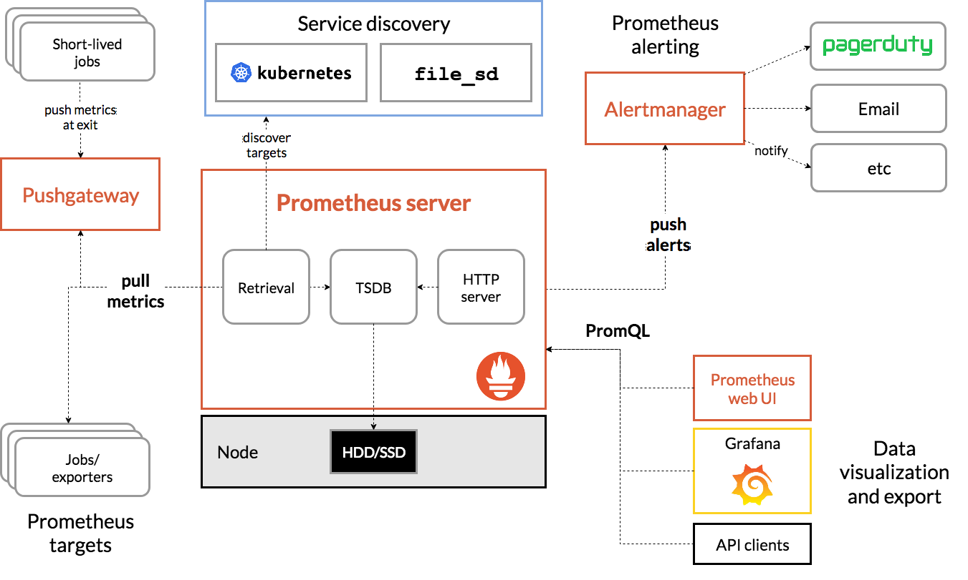

Slide 10
Getting started with Prometheus
This guide is a "Hello World"-style tutorial which shows how to install, configure, and use Prometheus in a simple example setup. You will download and run Prometheus locally, configure it to scrape itself and an example application, and then work with queries, rules, and graphs to make use of the collected time series data.
Downloading and running Prometheus
Download the latest release of Prometheus for your platform, then extract and run it.
Configuring Prometheus to monitor itself
Prometheus collects metrics from monitored targets by scraping metrics HTTP endpoints on these targets. Since Prometheus also exposes data in the same manner about itself, it can also scrape and monitor its own health.
While a Prometheus server that collects only data about itself is not very useful in practice, it is a good starting example. Save the following basic Prometheus configuration as a file named prometheus.yml:

Slide 11
Getting started with Prometheus
global:
scrape_interval: 15s # By default, scrape targets every 15 seconds.
# Attach these labels to any time series or alerts when communicating with
# external systems (federation, remote storage, Alertmanager).
external_labels:
monitor: 'codelab-monitor'
# A scrape configuration containing exactly one endpoint to scrape:
# Here it's Prometheus itself.
scrape_configs:
# The job name is added as a label `job=<job_name>` to any timeseries scraped from this config.
- job_name: 'prometheus'
# Override the global default and scrape targets from this job every 5 seconds.
scrape_interval: 5s
static_configs:
- targets: ['localhost:9090']

Slide 12
Getting started with Prometheus
Starting Prometheus
To start Prometheus with your newly created configuration file, change to the directory containing the Prometheus binary and run:
# Start Prometheus.
# By default, Prometheus stores its database in ./data (flag --storage.tsdb.path).
./prometheus --config.file=prometheus.yml
Prometheus should start up. You should also be able to browse to a status page about itself at localhost:9090. Give it a couple of seconds to collect data about itself from its own HTTP metrics endpoint.You can also verify that Prometheus is serving metrics about itself by navigating to its metrics endpoint: localhost:9090/metrics

Slide 13
Getting started with Prometheus
Using the expression browser
Let us try looking at some data that Prometheus has collected about itself. To use Prometheus's built-in expression browser, navigate to http://localhost:9090/graph and choose the "Console" view within the "Graph" tab. As you can gather from localhost:9090/metrics, one metric that Prometheus exports about itself is called prometheus_target_interval_length_seconds (the actual amount of time between target scrapes). Go ahead and enter this into the expression console:
prometheus_target_interval_length_seconds
This should return a number of different time series (along with the latest value recorded for each), all with the metric name prometheus_target_interval_length_seconds, but with different labels. These labels designate different latency percentiles and target group intervals. If we were only interested in the 99th percentile latencies, we could use this query to retrieve that information:
prometheus_target_interval_length_seconds{quantile="0.99"}
To count the number of returned time series, you could write:
count(prometheus_target_interval_length_seconds)

Slide 14
Getting started with Prometheus
Using the graphing interface
To graph expressions, navigate to http://localhost:9090/graph and use the "Graph" tab.
For example, enter the following expression to graph the per-second rate of chunks being created in the self-scraped Prometheus:
rate(prometheus_tsdb_head_chunks_created_total[1m])
Starting up some sample targets
Let us make this more interesting and start some example targets for Prometheus to scrape. The Go client library includes an example which exports fictional RPC latencies for three services with different latency distributions. Ensure you have the Go compiler installed and have a working Go build environment (with correct GOPATH) set up. Download the Go client library for Prometheus and run three of these example processes:
# Fetch the client library code and compile example.
git clone https://github.com/prometheus/client_golang.git
cd client_golang/examples/random
go get -d
go build

Slide 15
Getting started with Prometheus
# Start 3 example targets in separate terminals:
./random -listen-address=:8080
./random -listen-address=:8081
./random -listen-address=:8082
You should now have example targets listening on http://localhost:8080/metrics, http://localhost:8081/metrics, and http://localhost:8082/metrics.
Configuring Prometheus to monitor the sample targets
Now we will configure Prometheus to scrape these new targets. Let's group all three endpoints into one job called example-random. However, imagine that the first two endpoints are production targets, while the third one represents a canary instance. To model this in Prometheus, we can add several groups of endpoints to a single job, adding extra labels to each group of targets. In this example, we will add the group="production" label to the first group of targets, while adding group="canary" to the second.
To achieve this, add the following job definition to the scrape_configs section in your prometheus.yml and restart your Prometheus instance:

Slide 16
Getting started with Prometheus
scrape_configs:
- job_name: 'example-random'
# Override the global default and scrape targets from this job every 5 seconds.
scrape_interval: 5s
static_configs:
- targets: ['localhost:8080', 'localhost:8081']
labels:
group: 'production'
- targets: ['localhost:8082']
labels:
group: 'canary'

Slide 17
Getting started with Prometheus
Go to the expression browser and verify that Prometheus now has information about time series that these example endpoints expose, such as the rpc_durations_seconds metric.
Configure rules for aggregating scraped data into new time series
Though not a problem in our example, queries that aggregate over thousands of time series can get slow when computed ad-hoc. To make this more efficient, Prometheus allows you to prerecord expressions into completely new persisted time series via configured recording rules. Let's say we are interested in recording the per-second rate of example RPCs (rpc_durations_seconds_count) averaged over all instances (but preserving the job and service dimensions) as measured over a window of 5 minutes. We could write this as: avg(rate(rpc_durations_seconds_count[5m])) by (job, service). Try graphing this expression. To record the time series resulting from this expression into a new metric called job_service:rpc_durations_seconds_count:avg_rate5m, create a file with the following recording rule and save it as prometheus.rules.yml:
groups:
- name: example
rules:
- record: job_service:rpc_durations_seconds_count:avg_rate5m
expr: avg(rate(rpc_durations_seconds_count[5m])) by (job, service)
To make Prometheus pick up this new rule, add a rule_files statement in your prometheus.yml. Restart Prometheus with the new configuration and verify that a new time series with the metric name job_service:rpc_durations_seconds_count:avg_rate5m is now available by querying it through the expression browser or graphing it.

Slide 18
Grafana support for Prometheus
Grafana supports querying Prometheus. The Grafana data source for Prometheus is included since Grafana 2.5.0 (2015-10-28).
Creating a Prometheus data source
To create a Prometheus data source:
Click on the Grafana logo to open the sidebar menu.
Click on "Data Sources" in the sidebar.
Click on "Add New".
Select "Prometheus" as the type.
Set the appropriate Prometheus server URL (for example, http://localhost:9090/)
Adjust other data source settings as desired (for example, turning the proxy access off).
Click "Add" to save the new data source.
Creating a Prometheus graph
Click the graph title, then click "Edit".
Under the "Metrics" tab, select your Prometheus data source (bottom right).
Enter any Prometheus expression into the "Query" field, while using the "Metric" field to lookup metrics via autocompletion.
To format the legend names of time series, use the "Legend format" input. For example, to show only the method and status labels of a returned query result, separated by a dash, you could use the legend format string {{method}} - {{status}}.
Tune other graph settings until you have a working graph.

